Slide 1
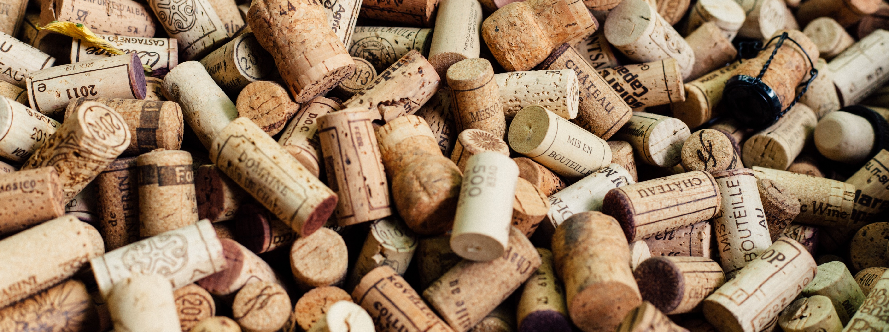
WINES & MACHINE-LEARNING Data Analytics Bootcamp UC Berkeley Extension 07.26.2018
Janaki Kora
Jessica Phillips
Lena Tran
Naz Sinaei
Sema Uyar

Slide 2

outline
Our data set
Our goal
Tools
Steps
Results
Improvements for future

Slide 3
Our Data Set
For our project, we are using data…
That was scraped from “Wine Enthusiast” by Zack T., “a full-stack software engineer who loves data science”
Our data set includes:
~130k wine reviews
13 data fields (Points, Title, Variety, Description, Country, Province, Region 1, Region 2, Winery, Designation, Price, Taster Name, Taster Twitter handle)
Our data sources:
https://www.kaggle.com/zynicide/wine-reviews/data
https://github.com/zackthoutt/wine-deep-learning

Slide 4
Our goal
Our goal is to develop a model that would predict the below based on the descriptions created by sommeliers.
The variety of a wine
The country of a wine
The winery of a wine

Slide 5
tools
Scikit-learn
Pandas
Matplotlib

Slide 6
STEP1
Data Collection/Acquisition
Identify wine varieties, countries, wineries that have more than a certain number of descriptions
Wine variety >1,000 observations
Country >1,000 observations
Winery >100 observations

Slide 7
STEP2
Data Pre-processing
Use NLTK library for stopword filtering and word tokenization
Use feature extraction text library (CountVectorizer and TFIDF Transformer) to extract features in a format supported by machine learning algorithms from datasets consisting of formats such as text
Use truncated SVD for dimensionality reduction of our features

Slide 8
STEP3
Model Training
Use train_test_split to split the data into 80% training and 20% testing
Use Random Forest Classifier and Gradient Boosting Classifier for model prediction

Slide 9
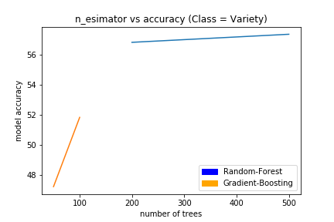
rESULTS

Slide 10
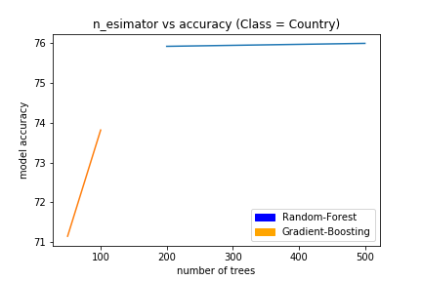
rESULTS

Slide 11
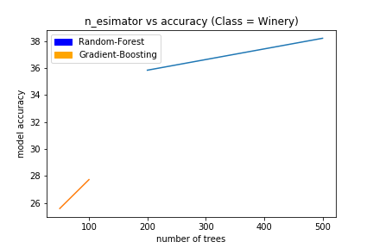
rESULTS

Slide 12
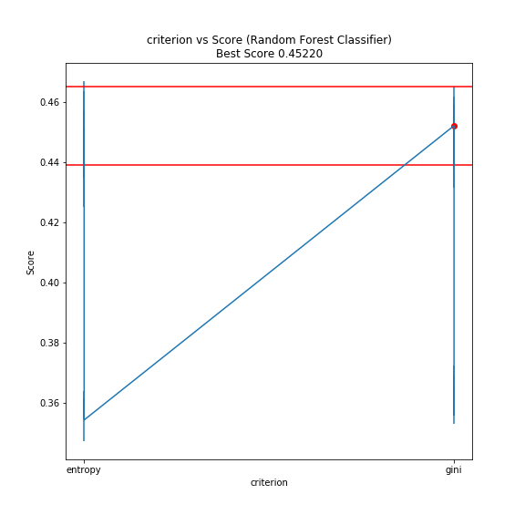
rESULTS

Slide 13
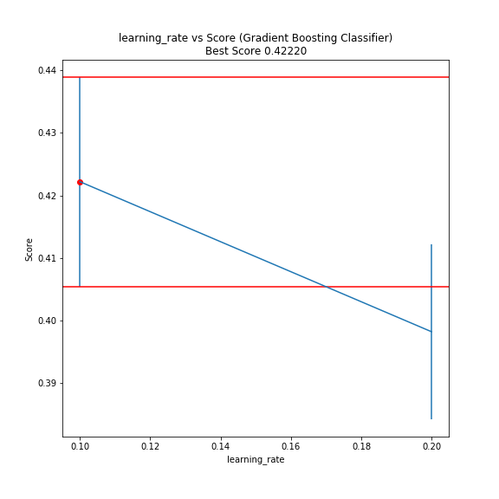
rESULTS

Slide 14
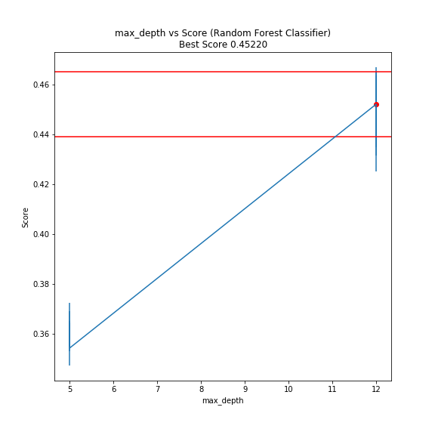
rESULTS

Slide 15
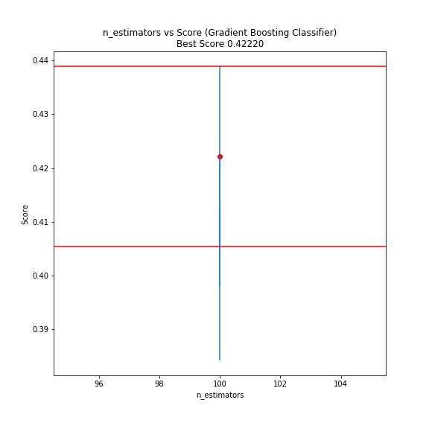
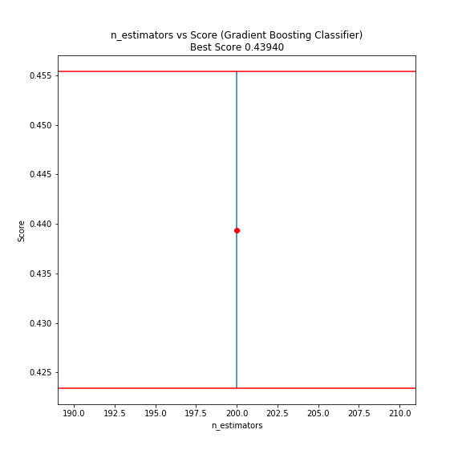
rESULTS

Slide 16
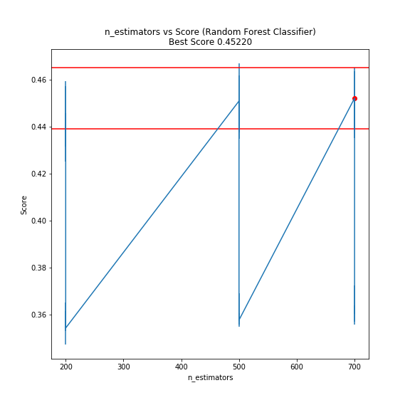
rESULTS

Slide 17
IMPROVEMENTS for future
Tune additional parameters
For random forest classifier:
Max features
For gradient boosting classifier:
Max depth
Criteria
Max features
Non-negative matrix factorization comparison to truncated SVD

Slide 18
Thank you!

